Slide 1
Blood Donation Database Management System
Presented By :-
Chandru
Faizal
Harsha
Naveen
Rakesh
Sandru
Sridhar

Slide 2
Introduction :
This document outlines the design of a database to hold all the data for Rotary Blood Bank in regards to their blood donation division.
This database holds all the information required for each transfusion/donation, including the required pre-exam, a global inventory to show inventory stocks at all locations, which can also be queried to narrow down to the specific location.
The data implemented into this database is fictional.

Slide 3
Tables Used :
People
Personal_details
Donor
Patient
Doctor
Pre_exam
Donation
Transfusion
Bloodbags
Locations
Inventory
Requests
Donation_records
Transfusion_records

Slide 4
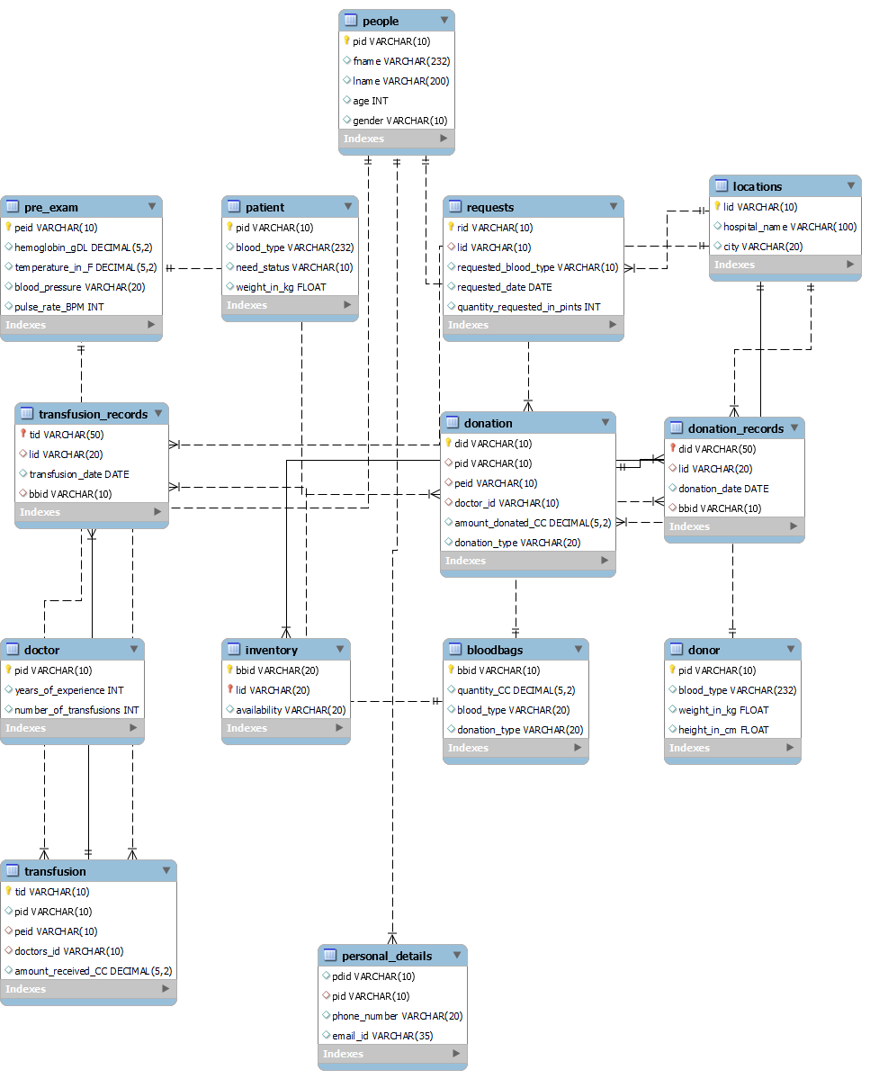
Entity Relationship Diagram :

Slide 5
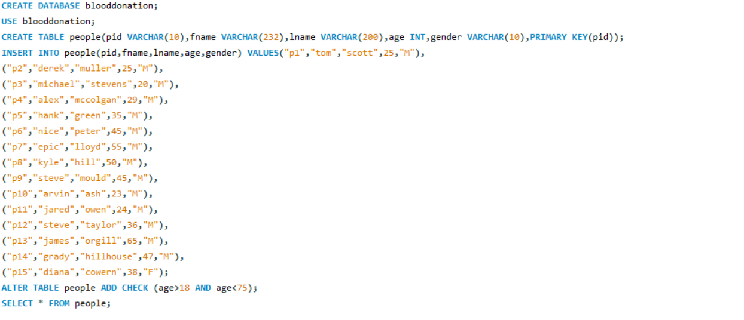
Creating blooddonation database and people table and inserting values :
-The people table contains all the details of people and their common attributes.

Slide 6
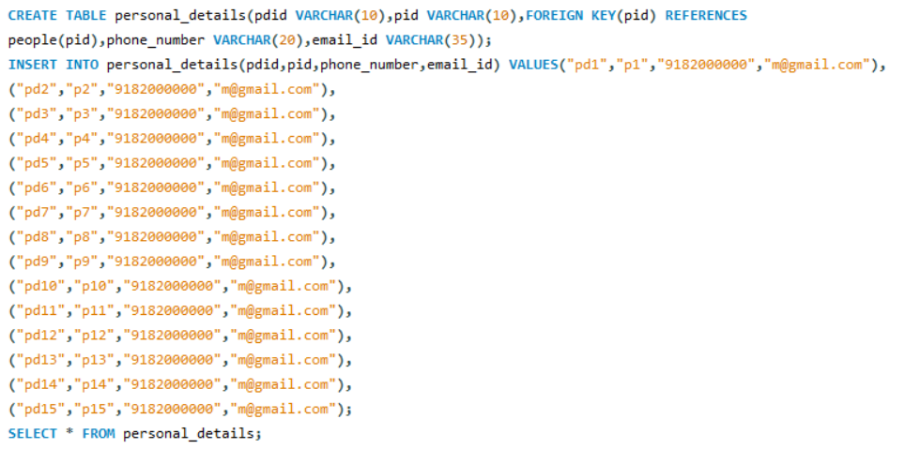
Creating personal_details table and inserting values :
- Contains personal details of all the people like email and phone number.

Slide 7
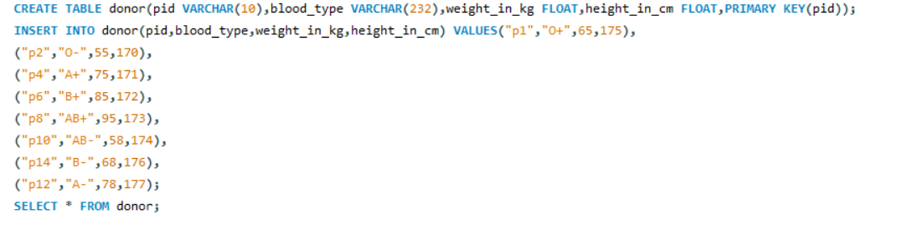
Creating donor table and inserting values :
- Contains information required to be a donor

Slide 8
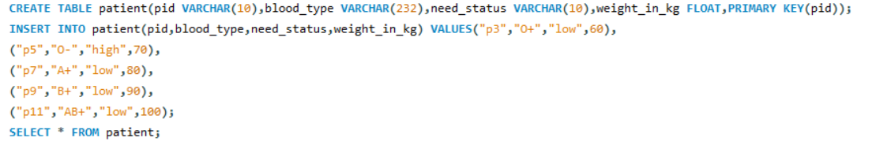
Creating patient table and inserting values :
- Contains all patients and their details before transfusion.

Slide 9
Creating doctor table and inserting values :
- Contains details of doctors and years of experience they have.

Slide 10
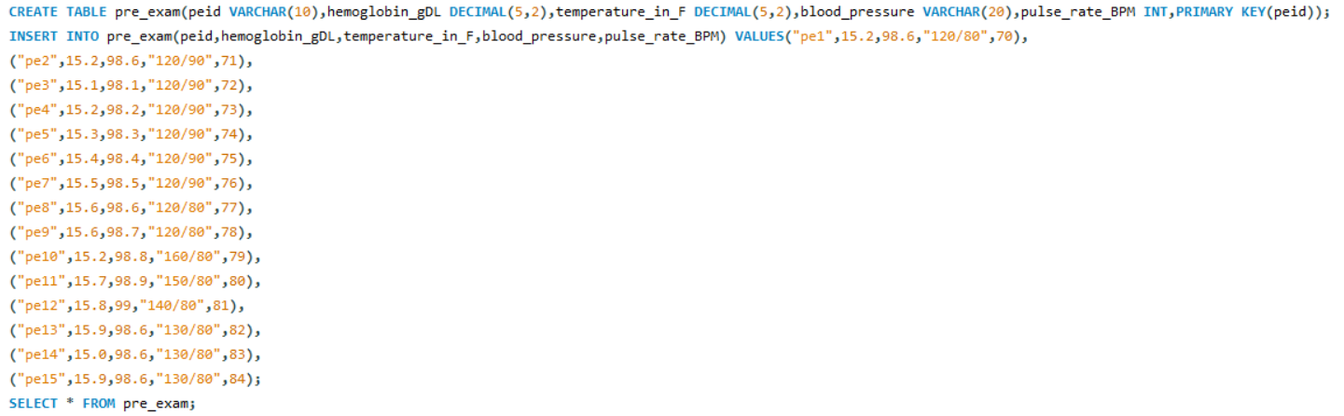
Creating pre_exam table and inserting values:
- Contains information about both donors and patients before and after donation and transfusion.

Slide 11
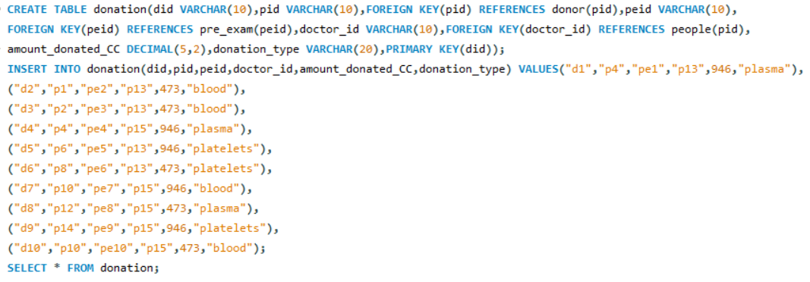
Creating donation table and inserting values:
- Contains the basic attributes about a blood donation.

Slide 12
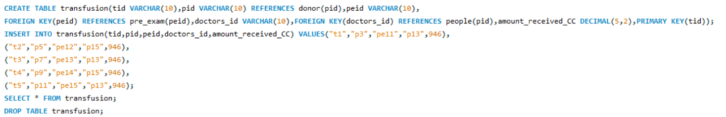
Creating transfusion table and inserting values:
- Contains basic attributes about a blood transfusion.

Slide 13
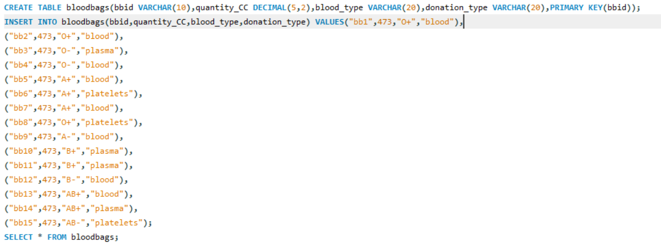
Creating bloodbags table and inserting values:
- Contains basic attributes about each blood bag.

Slide 14
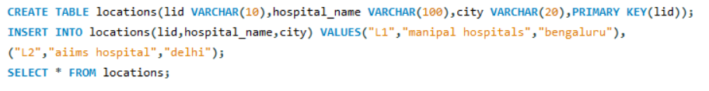
Creating locations table and inserting values:
- Contains all the hospital names with their locations.

Slide 15
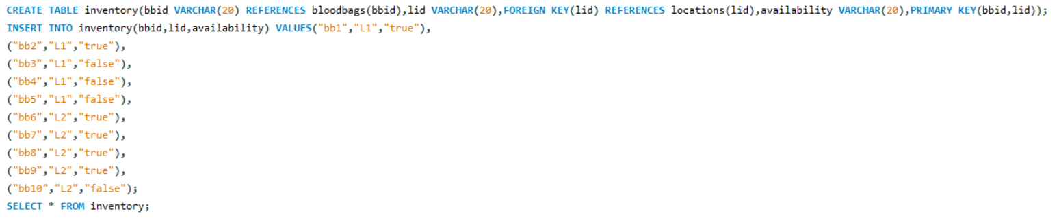
Creating inventory table and inserting values:
- Contains the global inventory of all the blood bags with the location in which they are stored.

Slide 16
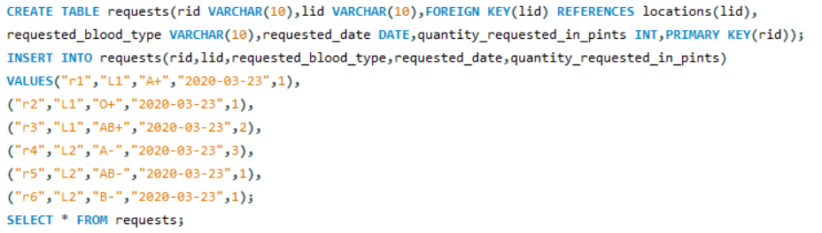
Creating requests table and inserting values:
- Contains attributes describing a request from a location.

Slide 17
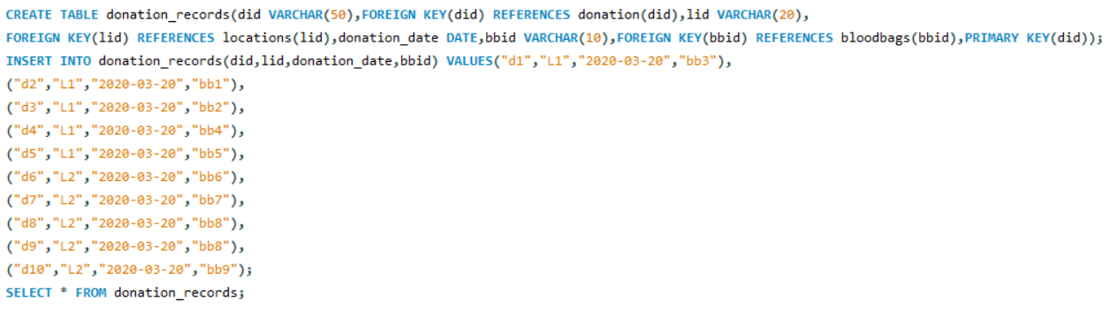
Creating donation_records table and inserting values:
- Provides more detailed records of all donations.

Slide 18
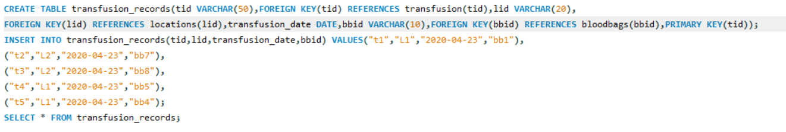
Creating transfusion_records table and inserting values:
- Provides more detailed records of all transfusions.

Slide 19
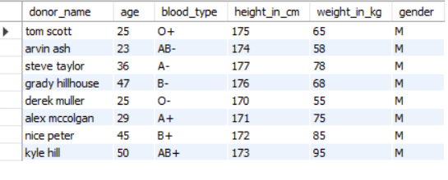
Q) Display the details of all donors ?
SELECT CONCAT(fname," ",lname) AS donor_name,age,blood_type,height_in_cm,weight_in_kg,gender FROM people JOIN donor ON people.pid = donor.pid;

Slide 20
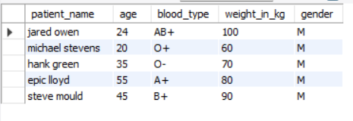
Q) Display the details of all patients ?
SELECT CONCAT(fname," ",lname) AS patient_name,age,blood_type,weight_in_kg,gender FROM people JOIN patient ON people.pid = patient.pid;

Slide 21

Q) Display the details of all doctors ?
SELECT CONCAT(fname," ",lname) AS doctor_name,age,years_of_experience,number_of_transfusions,gender FROM people JOIN doctor ON people.pid = doctor.pid;

Slide 22

Q) Display the details of patients who need blood immediately ?
SELECT CONCAT(fname," ",lname) AS patient_name,age,blood_type,weight_in_kg,gender FROM people JOIN patient ON people.pid = patient.pid WHERE need_status = "high";

Slide 23
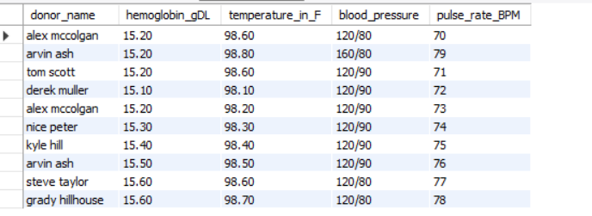
Q) Display the details of donors required before donation i.e pre_exam results?
SELECT CONCAT(fname," ",lname) AS donor_name,hemoglobin_gDL,temperature_in_F,blood_pressure,pulse_rate_BPM FROM donation JOIN pre_exam ON donation.peid = pre_exam.peid JOIN people ON people.pid=donation.pid;

Slide 24
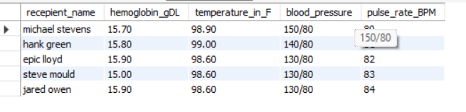
Q) Display the details of patients required before transfusion i.e pre_exam results?
SELECT CONCAT(fname," ",lname) AS recepient_name,hemoglobin_gDL,temperature_in_F,blood_pressure,pulse_rate_BPM FROM transfusion JOIN pre_exam ON transfusion.peid = pre_exam.peid JOIN people ON people.pid=transfusion.pid;

Slide 25
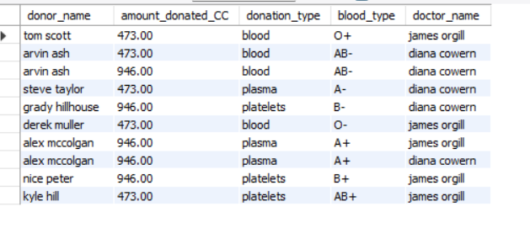
Q) Display the full name of donors along with their blood group,amount donated,donation type and name of doctor who extracted blood ?
SELECT CONCAT(people.fname," ",people.lname) AS donor_name,amount_donated_CC,donation_type,blood_type,CONCAT(p.fname," ",p.lname) AS doctor_name FROM donation JOIN people ON people.pid = donation.pid JOIN donor ON donor.pid=people.pid JOIN people AS p ON p.pid=donation.doctor_id;

Slide 26
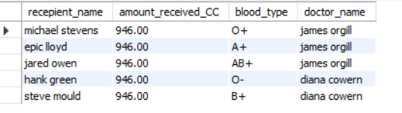
Q) Display the full name of recepients along with their blood type,amount received and name of doctor who did the transfusion ?
SELECT CONCAT(people.fname," ",people.lname) AS recepient_name,amount_received_CC,blood_type,CONCAT(p.fname," ",p.lname) AS doctor_name FROM transfusion JOIN people ON people.pid = transfusion.pid JOIN patient ON patient.pid=people.pid JOIN people AS p ON p.pid=transfusion.doctors_id;

Slide 27
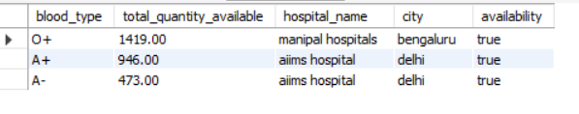
Q) if availability is true then how much blood of a specific type is available at a particular location ?
SELECT blood_type,quantity_CC * COUNT(blood_type) AS total_quantity_available,hospital_name,city,availability FROM inventory JOIN locations ON inventory.lid=locations.lid JOIN bloodbags ON bloodbags.bbid=inventory.bbid WHERE availability="true" GROUP BY blood_type;

Slide 28
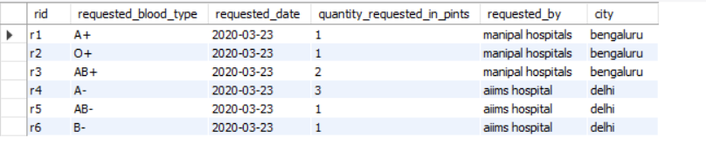
Q) display who requested a specific blood type along with the requested quantity and date ?
SELECT rid,requested_blood_type,requested_date,quantity_requested_in_pints,hospital_name AS requested_by,city FROM requests JOIN locations ON requests.lid=locations.lid;

Slide 29
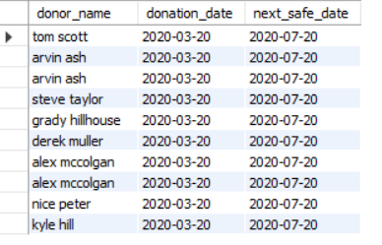
Q) dispaly the details of donors with recent donation dates and next safe date for donation ?
SELECT CONCAT(fname," ",lname) AS donor_name,donation_date,DATE_ADD(donation_date, INTERVAL + 4 MONTH) AS next_safe_date FROM donation JOIN donation_records ON donation.did = donation_records.did JOIN people ON people.pid=donation.pid;

Slide 30
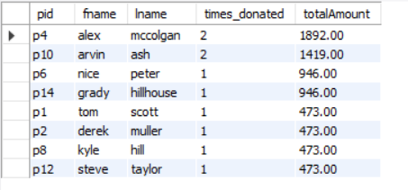
Q) display total times a donor has donated and the total amount in CC order by the total amount in descending order ?
SELECT p.pid,p.fname,p.lname,COUNT(d.pid) AS times_donated,SUM(d.amount_donated_CC) AS totalAmount FROM people p JOIN donation d ON p.pid=d.pid GROUP BY p.pid ORDER BY totalAmount DESC;

Slide 31
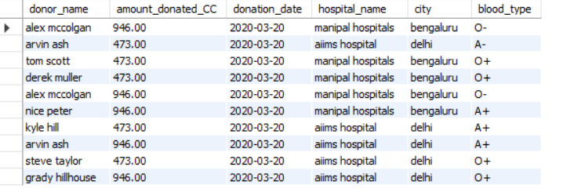
Q) display details of all donations and where they donated ?
SELECT CONCAT(fname," ",lname) AS donor_name,amount_donated_CC,donation_date,hospital_name,city,blood_type FROM donation JOIN donation_records ON donation_records.did=donation.did JOIN people ON people.pid=donation.pid JOIN locations ON locations.lid=donation_records.lid JOIN bloodbags ON donation_records.bbid=bloodbags.bbid;

Slide 32
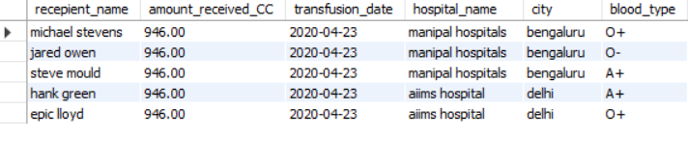
Q) display details of all transfusions and where they receieved ?
SELECT CONCAT(fname," ",lname) AS recepient_name,amount_received_CC,transfusion_date,hospital_name,city,blood_type FROM transfusion JOIN transfusion_records ON transfusion_records.tid=transfusion.tid JOIN people ON people.pid=transfusion.pid JOIN locations ON locations.lid=transfusion_records.lid JOIN bloodbags ON transfusion_records.bbid=bloodbags.bbid;

Slide 33


